Slide 1
Text Modelling Exercises

Slide 2

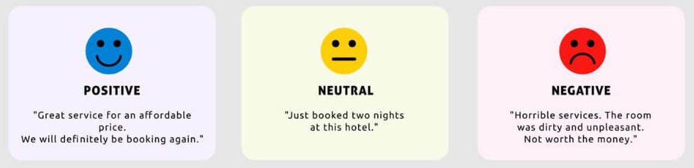
Text Modelling Exercise #1
You have tweets about Generative AI at your disposal. Classify each sentence as positive, negative or neutral depending on its tone.
Time: 20 minutes

Slide 3

















Text Modelling Exercise #1
You have tweets about Generative AI at your disposal. Classify each sentence as positive, negative or neutral depending on its tone.
Time: 20 minutes

Slide 4
Text Modelling Exercise #2
You have tweets about Generative AI at your disposal. Your task is to analyse the contents of the tweets and identify the main topics covered across the entire set.
Remember that the same tweet can cover multiple topics. For this reason, you do not necessarily have to assign a single topic to each article, but you can indicate all relevant topics present in each document.
Time: 20 minutes

Slide 5
Text Modelling Exercise #2

Slide 6


Text Modelling Exercise #2

Slide 7







Text Modelling Exercise #2

Slide 8















Text Modelling Exercise #2

Slide 9






























Text Modelling Exercise #2

Slide 10

Thanks!
Vito Giordano & Filippo Chiarello
DETAILLs Lab, Pisa

